Slide 1
Distance, Displacement, Speed, and Velocity

Slide 2
Distance
Distance (d) – how far an object travels.
Does not depend on direction.
Imagine an ant crawling along a ruler.
What distance did the ant travel?
d = 3 cm
0
1
2
3
4
5
6
7
8
9
10
cm

Slide 3
Distance
Distance does not depend on direction.
Now what distance did the ant travel?
d = 3 cm
Does his direction change the answer?
0
1
2
3
4
5
6
7
8
9
10
cm

Slide 4
Distance
Distance does not depend on direction.
Let’s follow the ant again.
What distance did the ant walk this time?
d = 7 cm
0
1
2
3
4
5
6
7
8
9
10
cm

Slide 5
Displacement
Displacement – difference between an object’s final position and its starting position.
Does depend on direction.
Displacement = final position – initial position
In order to define displacement, we need directions.
Examples of directions:
+ and –
N, S, E, W
Angles

Slide 6
Displacement vs. Distance
Example of distance:
The ant walked 3 cm.
Example of displacement:
The ant walked 3 cm EAST.
An object’s distance traveled and its displacement aren’t always the same!

Slide 7
Displacement
Let’s revisit our ant, and this time we’ll find its displacement.
Distance: 3 cm
Displacement: +3 cm
The positive gives the ant a direction!
-
+
0
1
2
3
4
5
6
7
8
9
10
cm

Slide 8
Displacement
Find the ant’s displacement again.
Remember, displacement has direction!
Distance: 3 cm
Displacement: -3 cm
-
+
0
1
2
3
4
5
6
7
8
9
10
cm

Slide 9
Displacement
Find the distance and displacement of the ant.
Distance: 7 cm
Displacement: +3 cm
-
+
0
1
2
3
4
5
6
7
8
9
10
cm

Slide 10
Displacement vs. Distance
An athlete runs around a track that is 100 meters long three times, then stops.
What is the athlete’s distance and displacement?
Distance = 300 m
Displacement = 0 m
Why?

Slide 11
Speed
Speed (s) – Rate at which an object is moving.
speed = distance / time
s = d/t
Like distance, speed does not depend on direction.

Slide 12
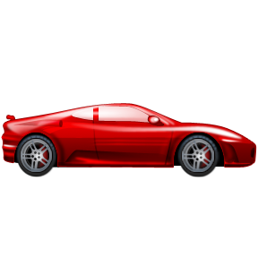
Speed
A car drives 100 meters in 5 seconds.
What is the car’s average speed?
s = d/t
s = (100 m) / (5 s) = 20 m/s
1 s
2 s
3 s
4 s
5 s
100 m

Slide 13
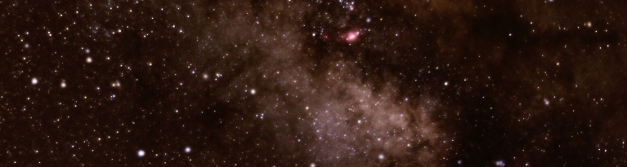
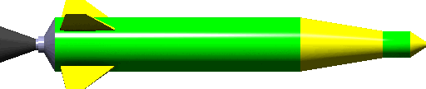
Speed
A rocket is traveling at 10 m/s. How long does it take the rocket to travel 30 m?

Slide 14
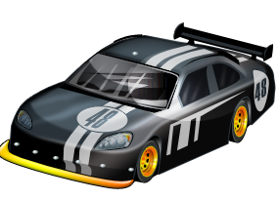
Speed
A racecar is traveling at 85.0 m/s. How far does the car travel in 30.0 s?

Slide 15
Velocity
Velocity (v) – speed with direction.
velocity = displacement / time
Has magnitude and direction!
Magnitude – a measure that has a value

Slide 16
Pulling It All Together
Back to our ant explorer!
Distance traveled: 7 cm
Displacement: +3 cm
Average speed: (7 cm) / (5 s) = 1.4 cm/s
Average velocity: (+3 cm) / (5 s) = +0.6 cm/s
-
+
1 s
2 s
3 s
4 s
5 s
0
1
2
3
4
5
6
7
8
9
10
cm

Slide 17
Visualising motion using distance-time graph and displacement-time graph

Slide 18
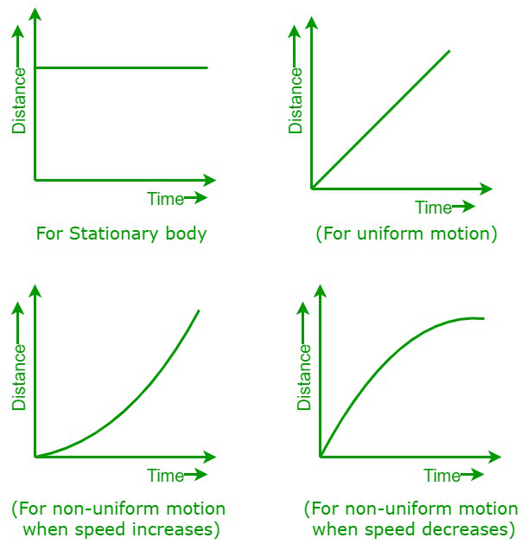
Distance-time graphs

Slide 19
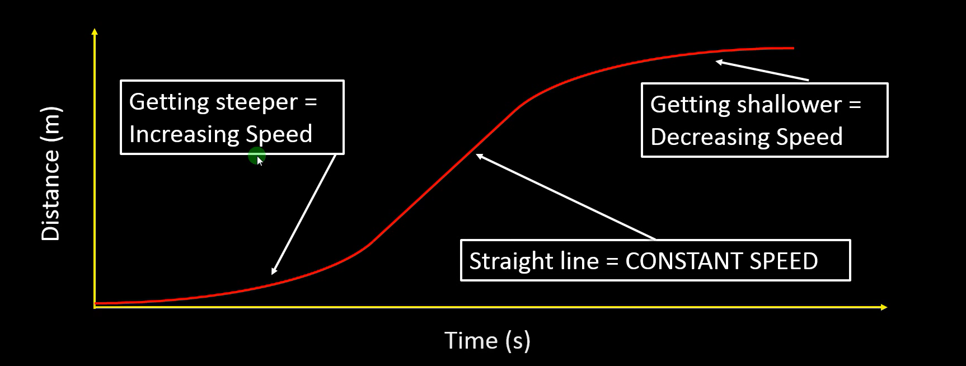
Distance-Time graph

Slide 20
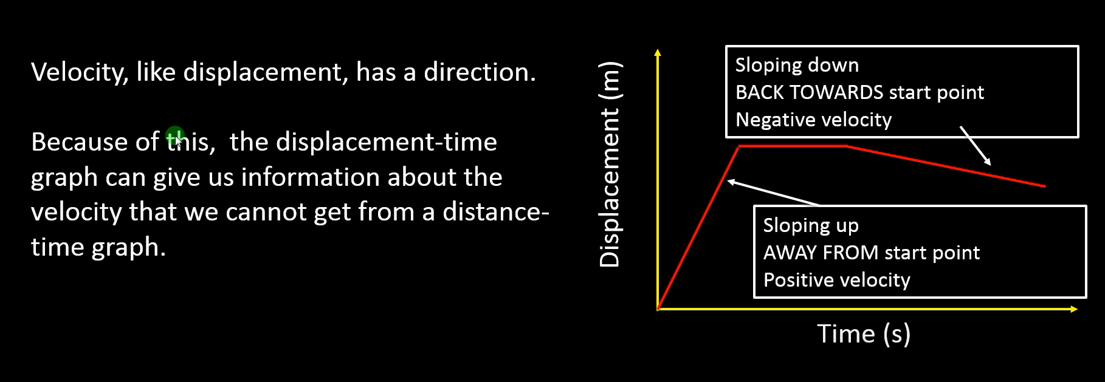
Understanding Velocity from a Displacement-Time graph

Slide 21
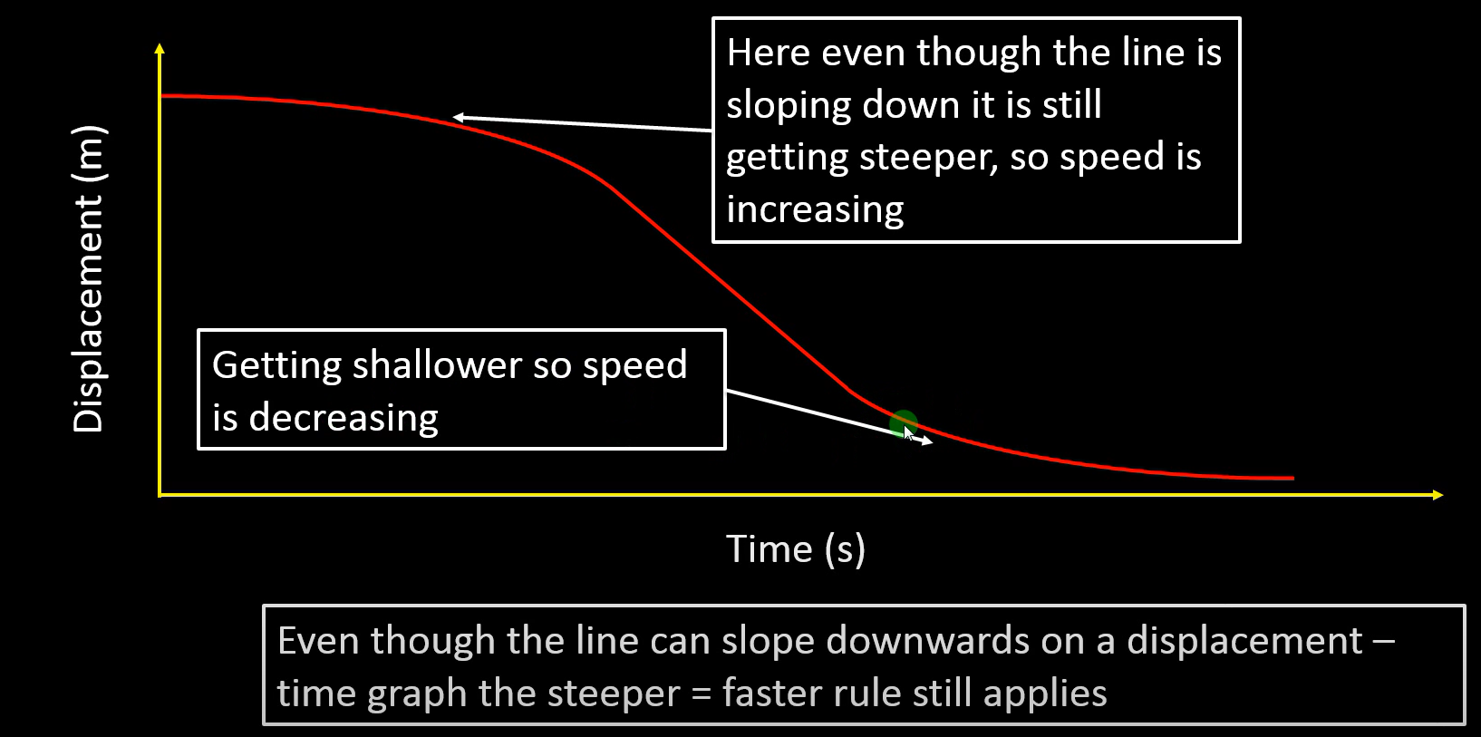
Displacement-time graph
Note the downward slope in the displacement-time graph indicates that it is returning back closer to the start point.

Slide 22
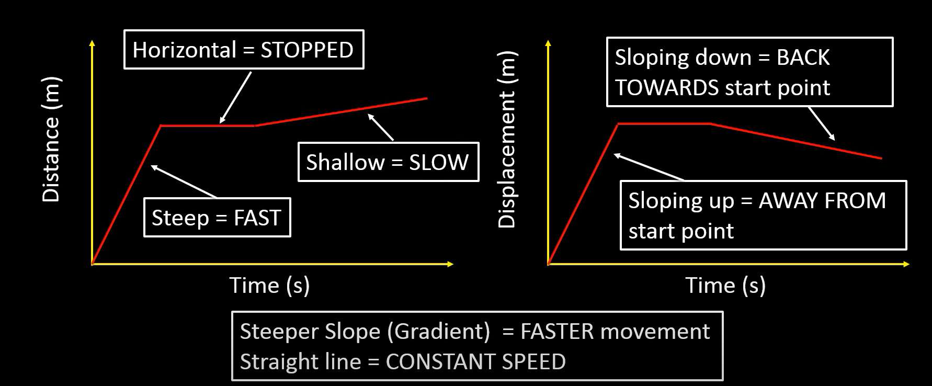
Distance-time graph vs Displacement-time graph
Difference between a distance-time graph and a displacement-time graph of an object going through the same journey.
Note the downward slope in the displacement-time graph indicates that it is returning back closer to the start point.

Slide 23
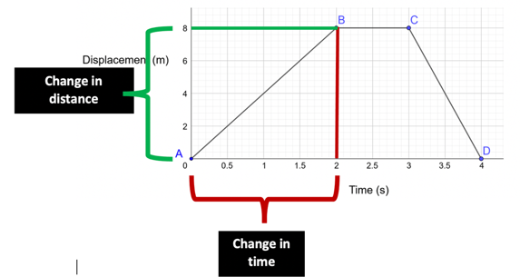
displacement

Slide 24
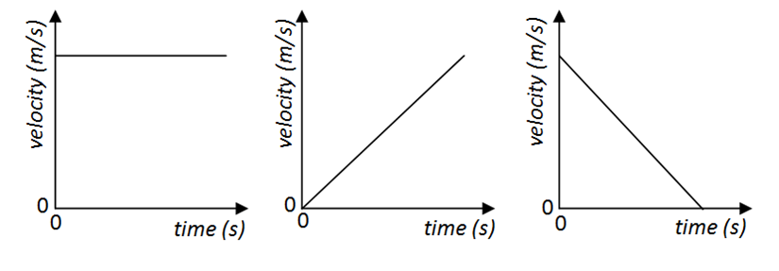
Velocity time graphs
Constant velocity
Constant acceleration
Constant deceleration

Slide 25
Acceleration
Acceleration is a vector quantity that describes how quickly an object's velocity changes. It's calculated as the change in velocity divided by the time interval over which that change occurs.

